Slide 1
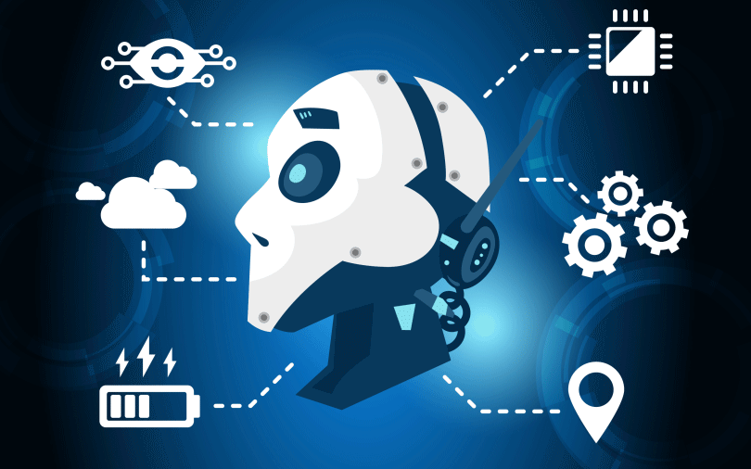
How AI Changing World!!
Presenters:
Hariram
Divya
Hyman
Jasmine

Slide 2
Introduction :
Artificial Intelligence (AI) means making computers and machines smart, so that they can do things that usually need human thinking.
AI helps machines:
Learn from data
Understand language
Recognize images and sounds
Make decisions and solve problems

Slide 3
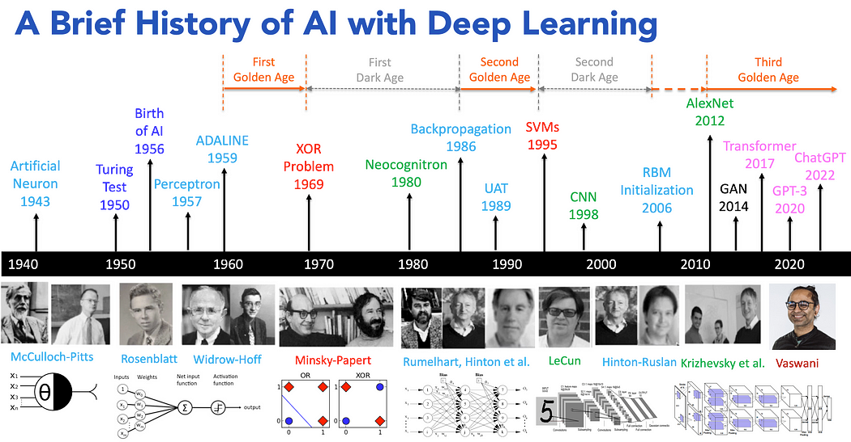

Slide 4
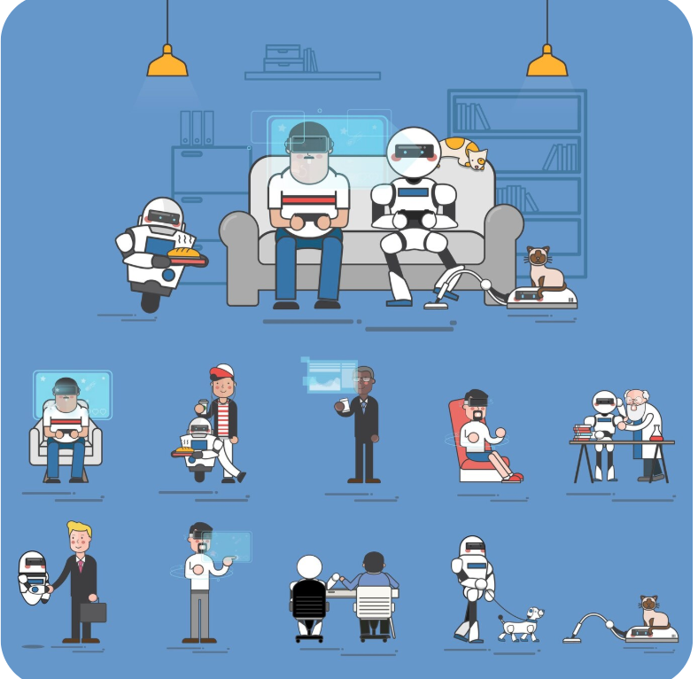
AI in Everyday Life:
Personalized Experiences
Smarter Communication
Intelligent Virtual Assistants
Health & Fitness Tracking
Notes:
Ai is around you 24/7
Lets take a walk through a day with ai ………you wake up-your phone face unlocks
You open utube-suggestions popup
Ask alexa for whether
Scrl Instagram- see your favorite food instantly.
That ai working behind this scenes.
I’m going to list some examples..raise your hands if you have used these recently
Ai is no longer a science fiction ..its your daily assistant

Slide 5
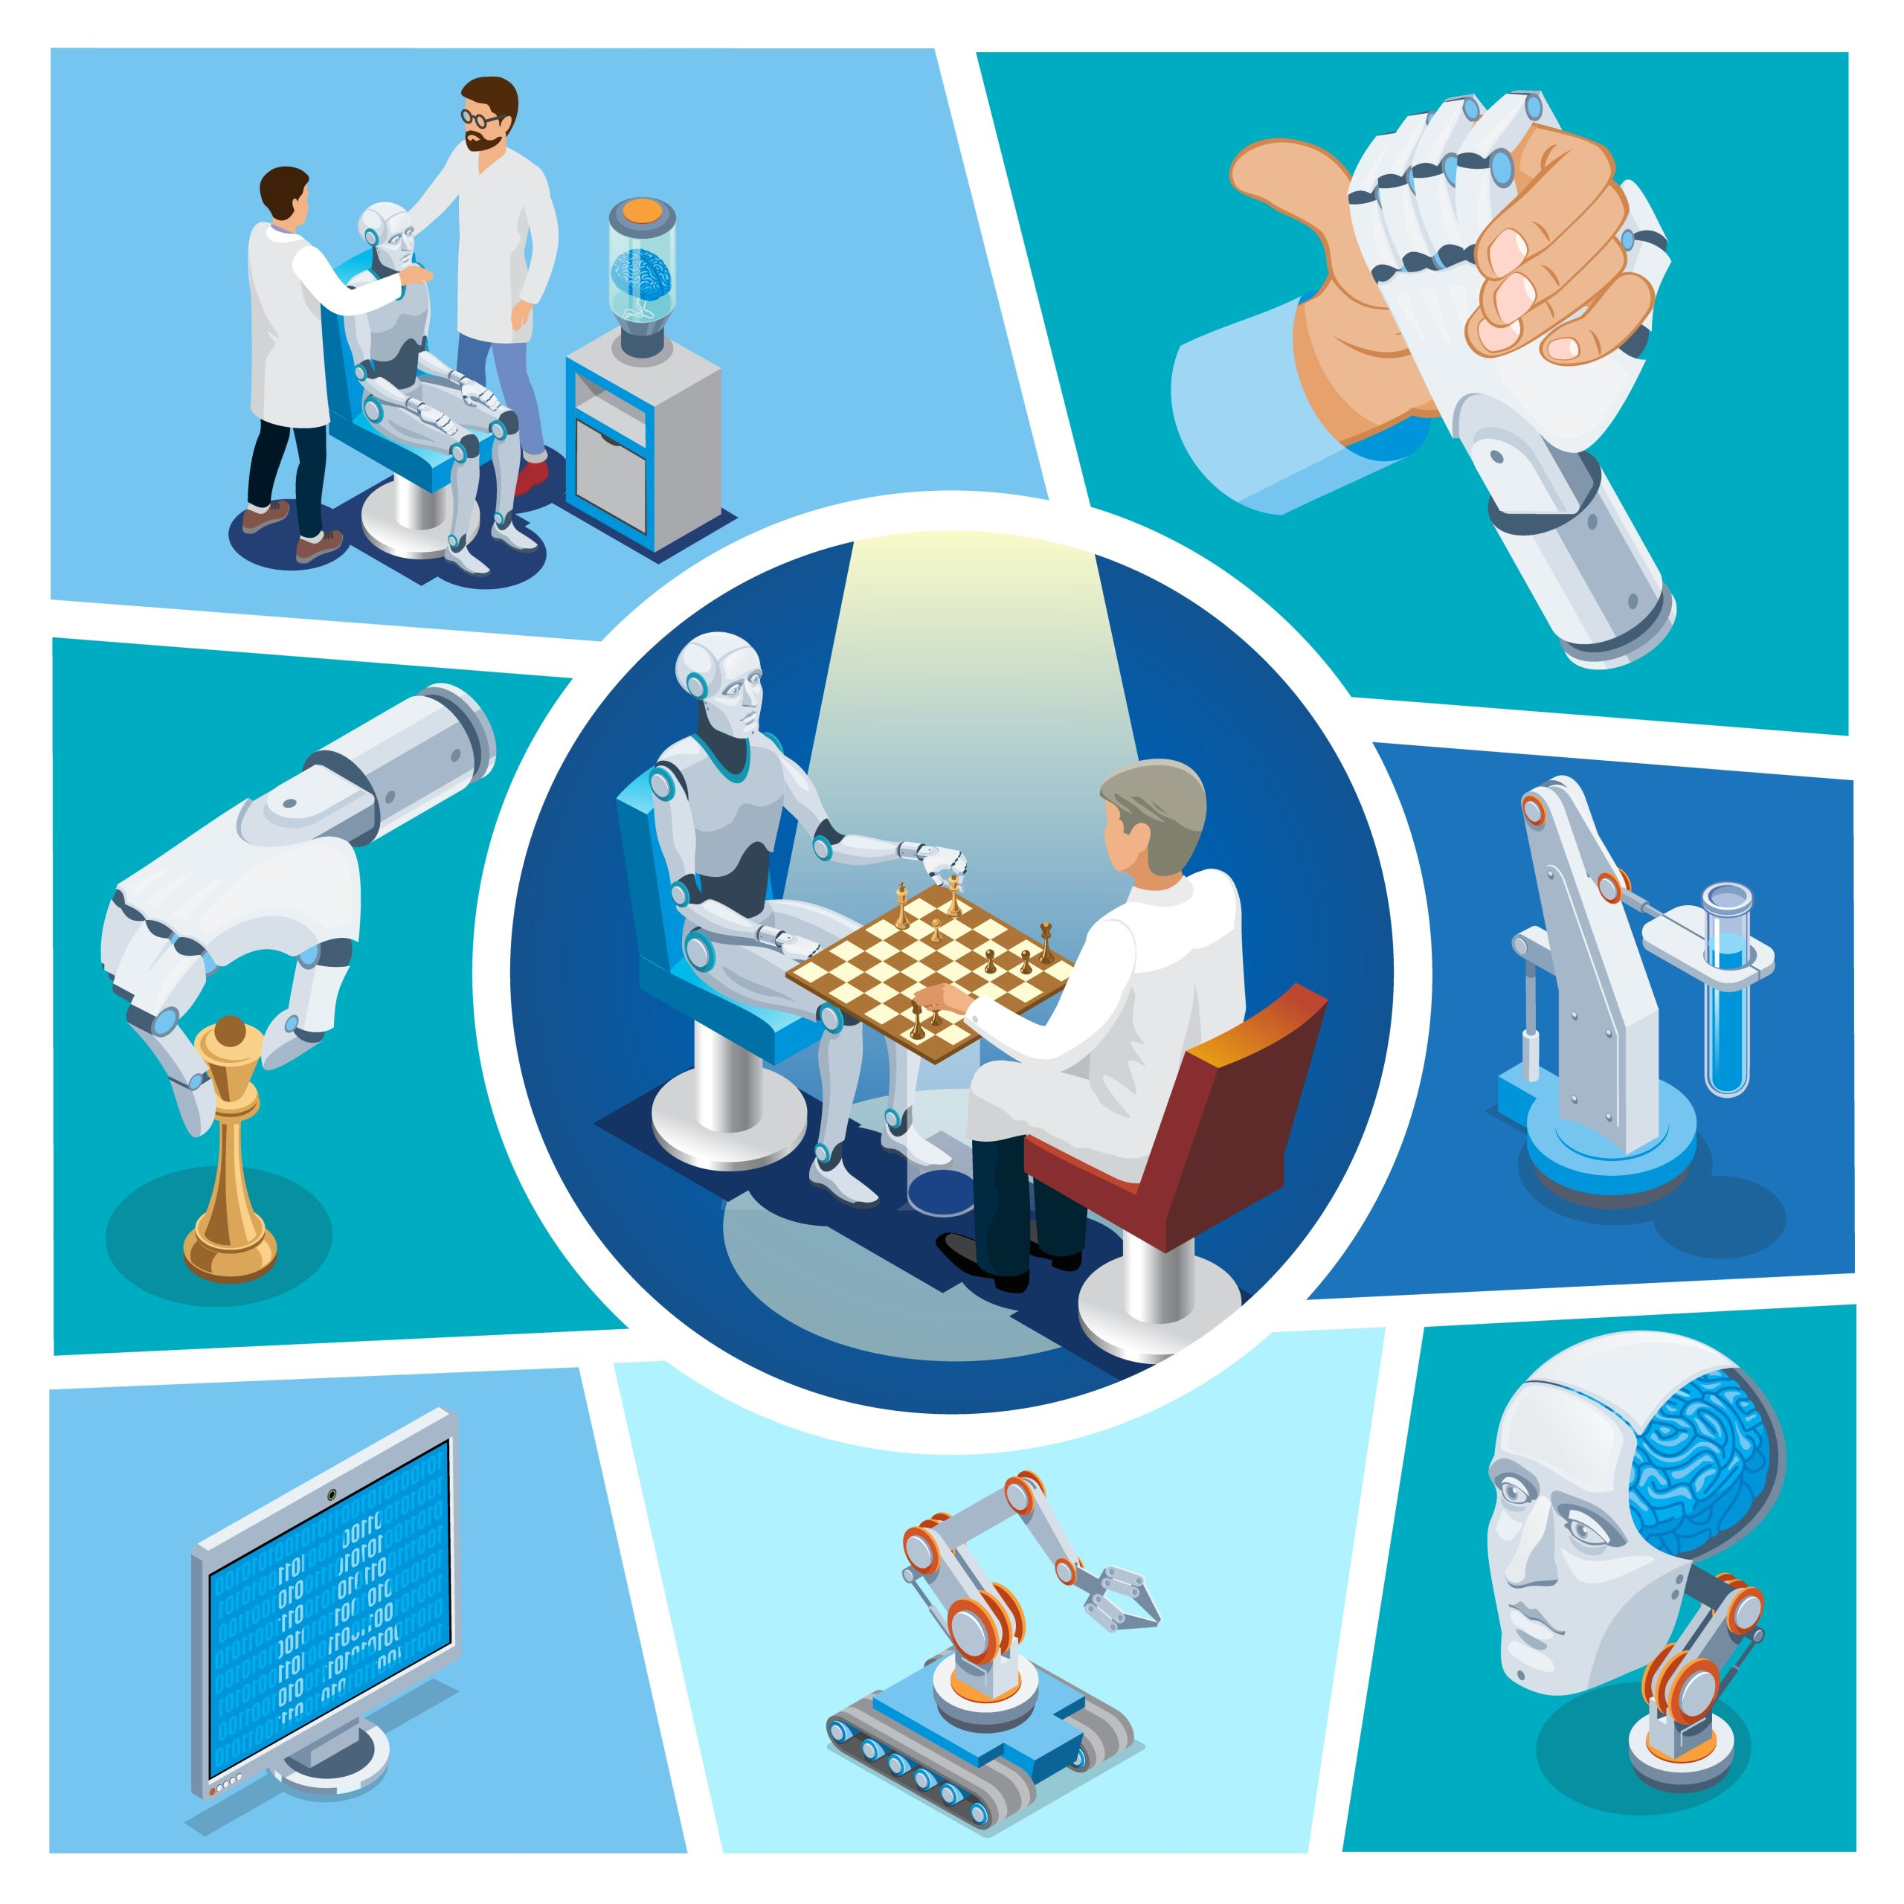
AI in Healthcare:
Artificial Intelligence is revolutionizing healthcare by enabling faster, more accurate diagnoses, personalized treatments, and predictive care.
Early Disease Detection
Personalized Medicine
AI-Enhanced Medical Imaging
Accelerated Drug Discovery
Notes:
Ai that saves lifes..
What if I told you a robot could detect the cancer faster than doctor ..do you agree..not in movie ion reality..
Yes it analyzes the medical images in secns
It predects the disesase before symptoms appears using patterns in data.
During covid-19 it helped tracking virs sprd,vaccine dvlpmnt

Slide 6
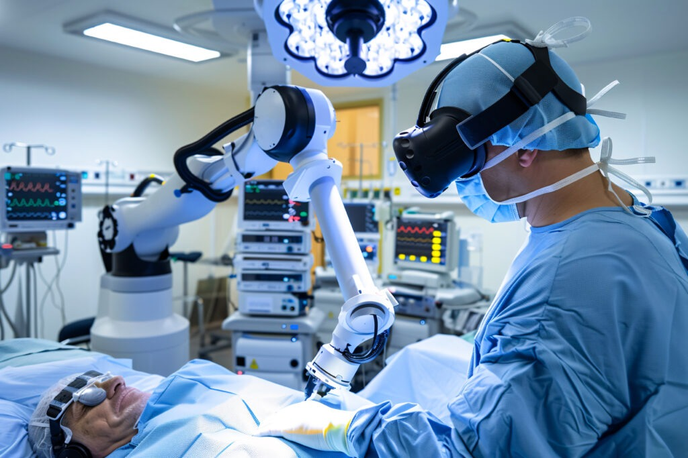
Notes:
By seeing this picture what comes In your mind?
Okay let me ask you a question…would you trust AI surgeon? Yes/no
Yeah Ai doest replace doctor but it superpowers them to save lifes.

Slide 7
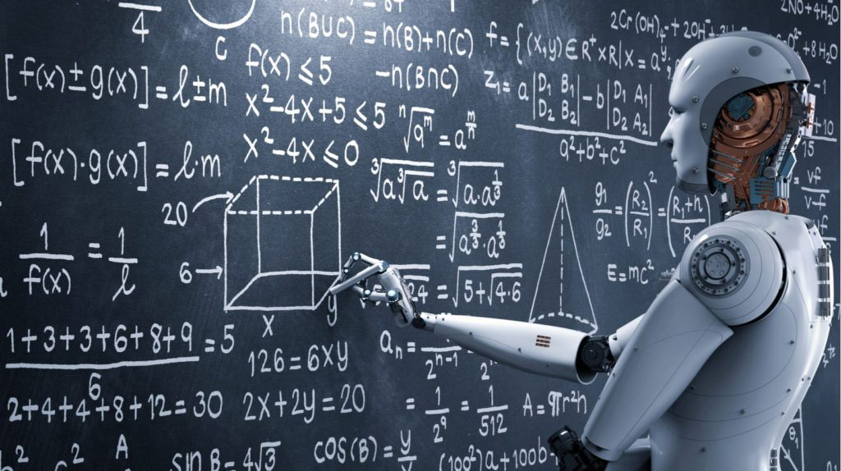
AI in Education:
AI is transforming education by enabling personalized learning, automating administrative tasks, and enhancing student engagement through intelligent tools.
Language Translation & Accessibility
Intelligent Tutoring Systems
Personalized Learning
Automated Grading
Notes:
Introduction: "Let’s begin with how AI is transforming education. It’s not just about smart classrooms—it’s about smarter learning.“
30 November 2022
Key Points:
Language Translation & Accessibility: AI tools like real-time translation and text-to-speech make learning accessible to students across languages and abilities.
Intelligent Tutoring Systems: These systems act like personal tutors, adapting to each student’s pace and providing instant feedback.
Personalized Learning: AI analyzes student performance and tailors content to individual needs, making learning more effective.
Automated Grading: Teachers save time with AI grading tools, allowing them to focus more on teaching than paperwork.
Audience Question:
“Do you think learning should be the same for everyone, or personalized using AI?”

Slide 8
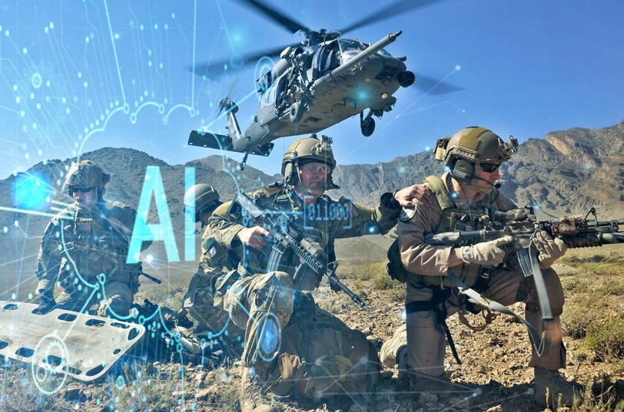
AI in Security & Defense :
AI enables faster responses to cyber threats, improves surveillance accuracy, and supports autonomous systems in military operations.
Real-Time Cyber Threat Detection
Advanced Surveillance & Facial Recognition
Autonomous Drones & Robots
AI-Driven Decision Support
Notes:
Opening Question to Audience:
“Have you ever wondered how cyberattacks are detected so quickly these days?”
(Encourage a few responses or nods.)
Since world is diving deep into digital era.
🛡️ Main Talking Points (1 minute)
Real-Time Cyber Threat Detection
AI monitors systems 24/7 and flags unusual activity instantly.
It’s like having a digital guard dog.
Ask: “Would you feel safer knowing AI is watching over your data?”
Advanced Surveillance & Facial Recognition
AI improves accuracy in identifying individuals and tracking movements.
Used in airports, borders, and public safety.
Ask: “Do you think facial recognition should be used everywhere?”
Autonomous Drones & Robots
AI powers unmanned vehicles for surveillance and rescue missions.
Reduces human risk in dangerous zones.
Ask: “Would you trust a robot to assist in a military operation?”
AI-Driven Decision Support
During war time AI helps commanders make faster, data-backed decisions.
Provide every possiblitiy
Combines satellite data, troop movements, and threat analysis.
Ask: “Can AI make better decisions than humans in high-pressure situations?”
🔚 Transition to Final Slide
“So, from classrooms to battlefields, AI is reshaping how we learn and protect. Let’s see one more area where AI is making a big impact.”

Slide 9
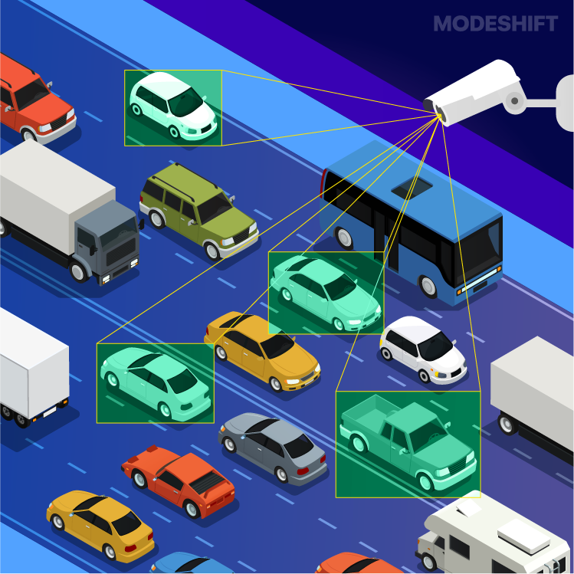
AI in Transportation:
Artificial Intelligence is revolutionizing in many ways, from autonomous vehicles to smart traffic systems, AI is reshaping how people and goods move around the world.
Self-Driving Vehicles
Smart Traffic Management
Predictive Maintenance
Logistics & Route Optimization
Notes:
Slide 3: AI in Transportation (1 minute)
Transition: "Finally, let’s hit the road—AI is revolutionizing how we move people and goods."
Key Points:
Self-Driving Vehicles: AI enables cars to navigate traffic, avoid obstacles, and make real-time decisions.
Smart Traffic Management: AI systems optimize traffic flow, reducing congestion and travel time.
Predictive Maintenance: Vehicles can now alert owners before a breakdown happens, improving safety and efficiency.
Logistics & Route Optimization: AI finds the fastest, most fuel-efficient delivery routes, saving time and resources.
Audience Question:
“Would you feel safe riding in a fully autonomous vehicle with no human driver?”

Slide 10
Ethical Challenges of AI:
AI systems can inherit biases from training data, leading to unfair treatment in areas like hiring, lending, or law enforcement.
AI collects and analyzes vast amounts of personal data, raising concerns about surveillance and data misuse.
Automation powered by AI threatens jobs in manufacturing, customer service, and even professional sectors.
When AI systems make decisions, it's often unclear who is responsible if something goes wrong.
Notes:
Do you have any challenges in your life?
Ai used in hiring ,heakthcare
Applied a job
Bias in AI
Privacy issues(talk nea your phone)
Job loss
Accountability(harmful dei=cison)

Slide 11
Future of AI :
Future AI systems may evolve beyond narrow tasks to perform human-like reasoning and learning across multiple domains.
AI will play a major role in tackling climate change, managing pandemics, and optimizing global supply chains.
As AI becomes more powerful, there will be a greater push for global regulations, ethical frameworks, and transparency.
Tools like co-pilots for coding, design, and writing will become more advanced and intuitive.
Notes:
Imagine its 2030
Smarter.more huma-like ai
Solving big global problems(weather)
Rise of everday ai assiatnats
Ai co pilots for everyone

Slide 12
The Future Of Artificial Intelligence Official Trailer - Progressive World (720p, h264).mp4

Slide 13
Thank You

